Slide 1


ដេប៉ាតឺម៉ង: ពត៌មានវិទ្យា
Subject : Computer Architicture
Project : Exercise
បង្រៀនដោយលោកគ្រូ : Ouk Polyvann

Slide 2
ក្រុមទី ១
ល.រ | ឈ្មោះ | ពិន្ទុ | តូនាទី | ភាគរយនៃការយល់ដឹង
១ | ស៊ូ ចាន់រ៉ូជែម |  | Code, Slide,​Simulator
២ | សាំង មិញសុឺ
៣ | វិន ម៉េងឡុង
៤ | លី តុលា
៥ | វិបុល សុខលីម
៦ | លី ម៉េងហ៊ង
៧ | ស៊ន ចាន់ឆៃហុង
៨ | វ៉ាង វាន់ថេន

Slide 3
1. Microcontroller ជាឧបករណ័អេឡិចត្រូនិចដែលយើងបានប្រើប្រាស់វាជាច្រើននៅក្នុងជីវភាពប្រចាំថ្ងៃ។ វាជាប្រភេទស្វៀគ្វី IC បានប្រើជាញឹកញាប់ ក្នុងផ្ទះ សាលា នៅក្នុងទូរស័ព្ទ ទូទស្សន៏ ម៉ាសុីនថតចម្លង។​
Type of micro controller:​
- Harvard Architecture​
- Von Neumann Architecture​
- AVR​
- PIC​
- Hitachi​
- Motorola​
​

Slide 4
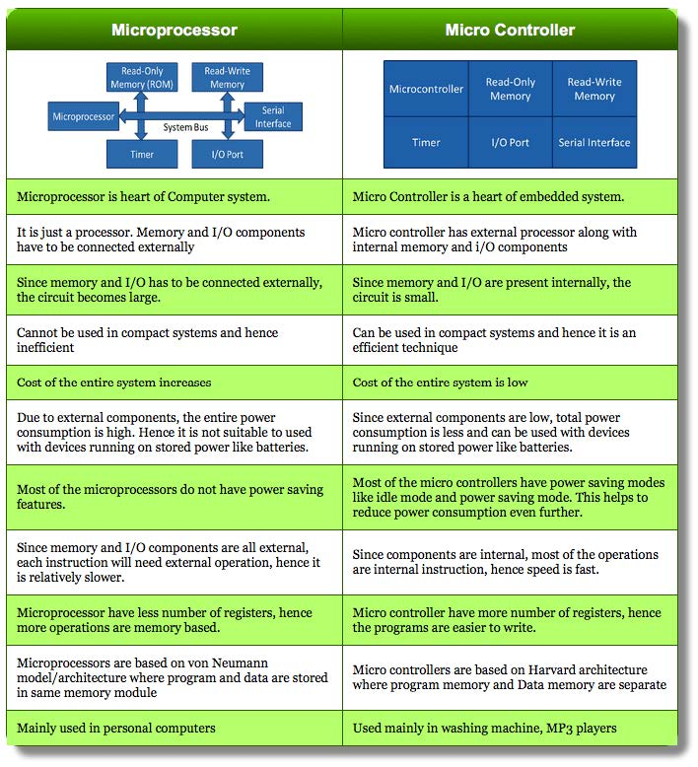
២.

Slide 5
3. Microcontroller អាចបង្កើតបានជា Computer ព្រេាះវាមានCPU
4. Arduino IDEជាកម្មវិធីមួយសម្រាប់អោយអ្នកប្រើប្រាស់សរសេរកូដ បង្កើតកម្មវិធី arduino ដើម្បីធ្វើការបញ្ជាទៅលើឪឧបករណ៍អេឡិចត្រូនិច Smart Phone និង រ៉ូបូតអោយដំណើរការដោយប្រើភាសា C, Python, Assembly នៅលើកុំព្យូទ័រ រួចupload code ទៅarduino board
វាមាន៥ប្រភេទ:
- arduino IDE
- arduino with ChromeBook
- micropython with arduino boards
- arduino PLC IDE - arduino IDE (LEGACY)
5. គេប្រើunoardusim ide សម្រាប់សរសេរនិងupload code ទៅក្នុងarduino board simulator។ គេត្រូវមាន void setup() and void loop()

Slide 6
6.
; ! Program to calculate 1 + 3 + 5 + ... + 2n-1
; ! Copyright (C) 2024, Brorojame2030@gmail.com
include 'emu8086.inc'
org 100h ; the program start at address 100h
.data
buffer dw 10 dup ('$')
; buffer dw '$', '$', '$', '$', '$', '$', '$', '$', '$', '$'
.code
mov ax, 0 ; sum = 0
mov bx, 5 ; n = 5
mov si, 1 ; i = 1
compare:
cmp si, bx ; si - bx
jg print_result ; jump to print_result if si > bx
addition:
push ax ; save ax in stack
mov al, 2 ; ah = 2
mul si ; (dx ax) = ax * si
sub ax, 1 ; ax = ax -1
mov cx, ax ; cx = ax
pop ax ; restore ax
add ax, cx ; ax = ax + cx
increment:
inc si ; si = si + 1
jmp compare ; jump to compare
print_result:
mov bx, 10 ; the number 10
mov cx, 0 ; counter in stack
loop1:
mov dx, 0; remainder
div bx ; ax = ax / 10 , dx = a % 10
add dx, '0' ; convert to ascii
push dx ; push dx to stack
inc cx ; increase the counter
cmp ax, 0 ; ax - 0
jnz loop1 ; jump to loop1 if result is not = 0, or if ZF = 0
print:
pop dx ; restore last number in stack
mov ah, 2 ; output char = dx in DOS
int 21h ; interrupt the program and execute interrupt handler = 21h in DOS
dec cx ; cx = cx - 1
cmp cx, 0 ; cx - 0
jnz print ; jump to print if result is not = 0, or if ZF = 0
wait:
mov ah, 0 ; read char from buffer
int 16h ; interrupt the program and execute interrupt handler = 16h in DOS
ret ; exit the program

Slide 7
// ! Program to calculate 1 + 3 + 5 + ... + 2n-1
void setup()
{
int n;
Serial.begin(9600);
while (!Serial.available())
{
}
delay(100);
n = Serial.parseInt();
int sum = 0;
for (int i = 1; i <= n; i++)
{
sum += 2 * i - 1;
}
Serial.print("THis sum is ");
Serial.println(sum);
}
void loop()
{
}

Slide 8
7. ; ! Program to find the even or odd number
; ! Copyright (C) 2024, Brorojame2030@gmail.com
include 'emu8086.inc'
org 100h ; start the program at address 100h
.data
buffer db 100, ?, 100 dup(0)
integer dw ?
.code
; start input
input:
PRINT 'number = ' ; scan string
mov ah, 0Ah
mov dx, offset buffer ; mov the address of buffer to dx
int 21h
mov bl , buffer[1] ; length of string
mov di , 0 ; sum counter
xor ax,ax ; clear ax
cmp bl, 1
je last_char
cmp buffer[2], '-' ; if the number is negative (the char -)
je next
;start loop1
loop1:
mov si, 1 ; i= 1
mov ax, 1 ; p = 1
; start loop_in_loop1
loop_in_loop1: ; 10 * 10 * ....
mov cx, 10
mul cx ; (dx ax) = ax * cx
inc si
cmp si, bx
jl loop_in_loop1
; end loop_in_loop1
xor cx,cx
mov cl, buffer[di+2] ; move the char in buffer
sub cx, '0' ; convert to number
mul cx ; multiply ax by cx
next: ; for next char in buffer
dec bx
inc di
push ax ; push to the stack
cmp bx, 1
jg loop1
; end loop1
;start last_char
last_char:
xor ax,ax
mov al, buffer[di+2] ; move the last char
sub ax, '0'
push ax ; push to the stack
;end last_char
xor ax,ax ;clear ax
xor cx, cx ; clear cx
mov cl, buffer[1] ; length of string

Slide 9
sum:
pop bx ; pop the top of the stack to bx
add ax, bx ; ax = ax + bx
dec cx
cmp cx, 0
jg sum
; end input
check:
PRINTN
test ax, 1 ; like and (LOGICAl AND) but for flag only, SF = most significant bit
jnz odd ; jump if SF = 0 (if the result is POSITIVE/0 , >= 0)
; else make it positive
even:
PRINT 'The number is even'
jmp wait
odd:
PRINT 'The number is odd'
jmp wait
wait:
mov ah, 0
int 16h
ret

Slide 10
; ! a simple calculator program
; ! support operator (+, -, *, /)
; ! Copyright (C) 2024, Brorojame2030@gmail.com
include 'emu8086.inc'
org 100h ; start the program at address 100h
.data
buffer db 100, ?, 100 dup(0)
x dw ?
sign dw ?
y dw ?
.code
mov cx, 0 ; counter
push cx ; push to stack
jmp input_x ; jump to input x
; start input number
; start input string
input:
mov ah, 0Ah
mov dx, offset buffer ; mov the address of buffer to dx
int 21h
; end input string
mov bl , buffer[1] ; length of string
mov di , 0 ; sum counter
xor ax,ax ; clear ax
cmp bl, 1 ; if the length of string = 1?
je last_char
cmp buffer[2], '-' ; if the number is negative (the char -)
je next
;start loop1
loop1:
mov si, 1 ; i= 1
mov ax, 1 ; p = 1
; start loop_in_loop1
loop_in_loop1: ; 10 * 10 * ....
mov cx, 10
mul cx ; (dx ax) = ax * cx
inc si
cmp si, bx
jl loop_in_loop1
; end loop_in_loop1
xor cx,cx
mov cl, buffer[di+2] ; move the char in buffer
sub cx, '0' ; convert to number
mul cx ; multiply ax by cx
next: ; for next char in buffer
dec bx
inc di
push ax ; push to the stack
cmp bx, 1
jg loop1
; end loop1
;start last_char
last_char:
xor ax,ax
mov al, buffer[di+2] ; move the last char
sub ax, '0'
push ax ; push to the stack
;end last_char
xor ax,ax ;clear ax
xor cx, cx ; clear cx
mov cl, buffer[1] ; length of string
sum:
pop bx ; pop the top of the stack to bx
add ax, bx ; ax = ax + bx
dec cx
cmp cx, 0
jg sum

Slide 11
; end input number
pop cx
cmp cx, 0
je save_x
jne save_y
; start input x, sign, y
input_x:
PRINT 'Enter x: '
jmp input
save_x:
mov [x], ax
inc cx
push cx
input_operator:
PRINTN
PRINT 'Select(+,-,*,/): '
xor ax, ax
mov ah, 01h ; al = character read
int 21h
xor ah, ah
mov [sign], ax
input_y:
PRINTN
PRINT 'Enter y: '
jmp input
save_y:
mov [y], ax
; end input x, sign, y
;start calculate
calculate:
mov ax, [x]
mov bx, [y]
cmp [sign], '+'
je add
cmp [sign], '-'
je minus
cmp [sign], '*'
je multiply
cmp [sign], '/'
je divide
add:
add ax, bx
jmp print_add
minus:
sub ax, bx
jmp print_minus
multiply:
mul bx ; (dx ax) = ax * bx
jmp print_multiply
divide:
xor dx, dx
div bx ; ax = (dx ax) / bx
jmp print_divide
;end calculate
; start print type
print_add:
PRINTN
PRINT 'The result of adds two number is '
jmp print_result
print_minus:
PRINTN
PRINT 'The result of subtact two number is '
jmp print_result
print_multiply:
PRINTN
PRINT 'The result of multiply two number is '
jmp print_result
print_divide:
PRINTN
PRINT 'The result of divide two number is '
jmp print_result
; end print type
; start print_result
print_result:
mov bx, 10 ; the number 10
mov cx, 0 ; counter in stack
loop2:
mov dx, 0; remainder
div bx ; ax = ax / 10 , dx = a % 10
add dx, '0' ; convert to ascii
push dx ; push dx to stack
inc cx ; increase the counter
cmp ax, 0 ; ax - 0
jnz loop2 ; jump to loop2 if result is not = 0, or if ZF = 0
print:
pop dx ; restore last number in stack
mov ah, 2 ; output char = dx in DOS
int 21h ; interrupt the program and execute interrupt handler = 21h in DOS
dec cx ; cx = cx - 1
cmp cx, 0 ; cx - 0
jnz print ; jump to print if result is not = 0, or if ZF = 0
;end print_result
wait:
mov ah, 01h
int 21h
ret

Slide 12
// ! calculator program
void setup()
{
int x, y;
char sign;
Serial.begin(9600);
Serial.print("Enter x: ");
while (!Serial.available())
{
}
x = Serial.parseInt();
delay(100);
Serial.println(x);
Serial.print("Select(+,-,*,/): ");
while (!Serial.available())
{
}
sign = Serial.read();
Serial.println(sign);
Serial.print("Enter y: ");
while (!Serial.available())
{
}
y = Serial.parseInt();
delay(100);
Serial.println(y);
switch (sign)
{
case '+':
Serial.print("The result of adds two number is ");
Serial.println(x + y);
break;
case '-':
Serial.print("The result of subtract two number is ");
Serial.println(x - y);
break;
case '*':
Serial.print("The result of multiply two number is ");
Serial.println(x * y);
break;
case '/':
Serial.print("The result of divide two number is ");
Serial.println(x / y);
break;
}
}
void loop()
{
}

Slide 13
9. setup(): ដំណើរការតែមួយដងពេល run program
Loop(): ដំណើរការរហូតពេល run program
PinMode(): បើកជើងPIN
DigitalWrite(): បើកឲLED ភ្លឺ
Delay(): ពន្យារពេល
Begin(): rate of serial communication
Print(): print string/number to console
Read(): input data from buffer
ParseInt(): convert to integer
AnalogWrite(): Writes an analog value (PWM wave) to a pin. Can be used to light a LED at varying brightnesses or drive a motor at various speeds
Available(): input to buffer

